Slide 1
MATLAB ASSIGNMENT 2
BY: Group 12

Slide 2
PARTICIPANTS OF GROUP 12
NAME | REGISTRATION NUMBER | PROGRAM OF STUDY
OBBO DANIEL BENJAMIN | BU/UP/2024/1054 | WAR
TANGA RIGAN | BU/UP/2024/1071 | WAR
MIREMBE ROSE | BU/UP/2024/3835 | WAR
AGABA JOSHUA | BU/UP/2024/1009 | WAR
LWASAMPIJJA MIKE CRISPUS | BU/UG/2024/2678 | AMI
ISABIRYE EDMOND | BU/UP/2024/3733 | AMI
WANDABWA ELVIS | BU/UP/2024/1076 | WAR
APIO MIRIAM | BU/UP/2024/3827 | WAR
GINATH RUTH | BU/UP/2024/5468 | PTI

Slide 3
BRIEF DESCRIPTION
Assignment two was about loading data files used in assignment one into MATLAB and make different data visualizations and describing characteristics and relationships of data.

Slide 4
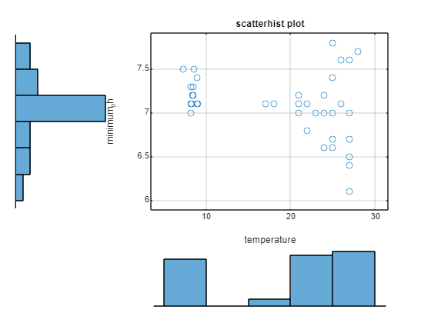
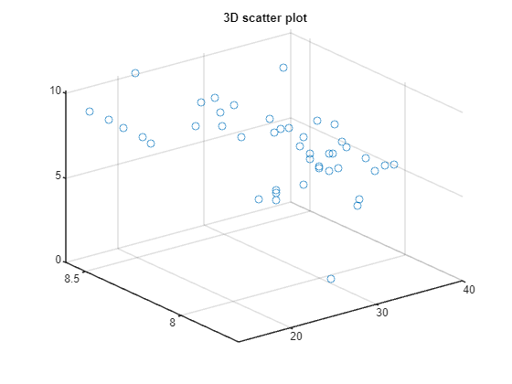
NUMBER ONE VISUALIZATIONS
Relationship between temperature_c_min and minimum_ph according to 2021
temperature_c_min = [21 25 26 24 23 23 24 25 21 22 22 18 25 27 27 27 28 27 22 24 24 25 22 23 17 27 27 27 26 25 21 8.5 8.6 8.4 8.3 8.2 8.9 8.9 9 8.2 8.5 8.2 8.9 7.3];
minimum_ph = [7.2 7.4 7.1 7 7 7 7 7 7.1 7.1 6.8 7.1 6.6 7.6 7 6.5 7.7 6.7 6.8 6.6 7.2 6.7 7.1 7 7.1 6.1 6.4 6.1 7.6 7.8 7 7.3 7.5 7.2 7.1 7.1 7.4 7.1 7.1 7.3 7.2 7 7.1 7.5];
scatterhist(temperature_c_min,minimum_ph);
xlabel('temperature');
ylabel('minimum_ph');
title('scatterhist plot');
grid on;
Relationship between temperature_c_max, disolved_max and maximum_ph according to 2021
temperature_c_max = [34 32 29 29 29 30 30 30 25 25 25 23 32 31 29 30 31 32 29 30 26 29 28 27 27 31 31 31 30 37 29 15 14.5000 14.5000 23 23 14 14 25 21 21 26 26 22];
maximum_ph = [8.1 8.1 8.5 7.9 8 8 8.2 7.8 8 8 8 8 7.7 8.2 8 7.9 8.3 7.8 8.6 8 7.9 7.9 7.7 8.1 7.8 7.9 7.8 7.7 8.1 8.5 8.4 8.2 8.5 8.4 8.3 8.2 8.3 8.2 7.7 8.1 8 7.9 7.7 8.6];
disolved_max = [8 8.5 8.2 7 7.2 6.6 7.8 5.3 5.3 5.9 5.7 5.6 8 7.7 7.5 7 7.7 7.1 6 6.5 6.6 8 6.5 8.5 1.4 8.1 8 8.1 7.3 8.9 8.3 9 9.4 9.4 9.8 9.7 9.5 9.5 9.6 9.7 9.6 9.4 10.2 10.1];
scatter3(temperature_c_max, maximum_ph, disolved_max);
title('3D scatter plot');

Slide 5
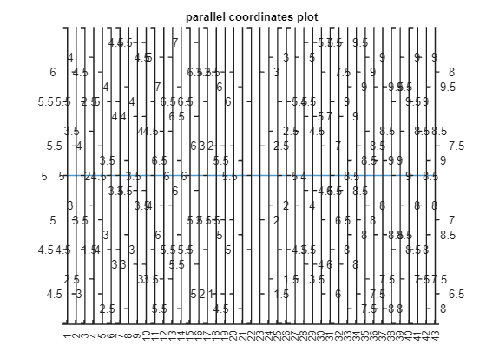
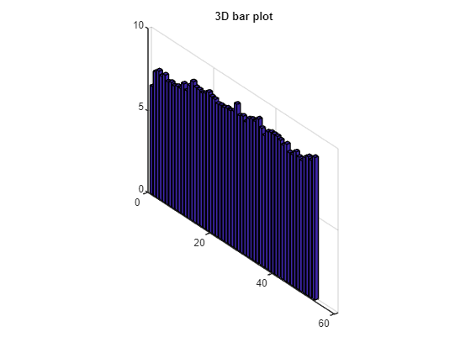
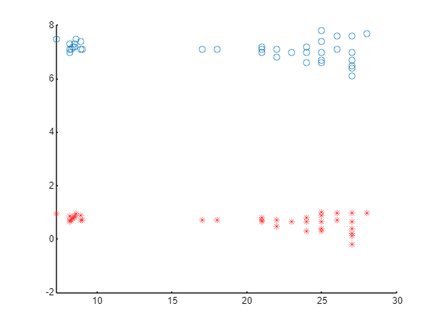
MORE OF NUMBER ONE
Parallel Coordinates plot of dissolved _min according to 2021
dissolved_min = [5 5.3 5 3.2 3.8 2 4.5 3.4 3.6 3.6 3.5 3.7 4.2 6.4 6 6.1 6 5.8 2.8 1.8 5.4 5.5 2.3 2.2 5 4. 4.2 4.6 6.6 6.8 8.5 8.6 8.4 8.3 8.2 8.9 8.9 9 8.2 8.5 8.2 8.9 7.3];
parallelplot(dissolved_min);
title('parallel coordinates plot');
3D Bar plot of maximum ph according 2022
maximum_ph = [6.6 7.6 7.8 7.6 7.8 7.5 7.6 7.5 7.6 7.6 8 7.7 8.14 8.5 8.27 8.25 8.18 8.3 8.48 8.32 8.29 8.13 8.17 8.16 8.25 8.22 8.32 8.86 8.27 8.38 8.14 8.46 8.56 8.55 8.82 8.38 8.05 8.4 8.5 8.5 8.5 8.4 8.2 8.4 8 8 8.3 8.1 8 8.3 8.5 8.4 8.7];
bar3(maximum_ph);
title('3D bar plot');
maximum_ph = x
temperature_c_min = [21 25 26 24 23 23 24 25 21 22 22 18 25 27 27 27 28 27 22 24 24 25 22 23 17 27 27 27 26 25 21 8.5 8.6 8.4 8.3 8.2 8.9 8.9 9 8.2 8.5 8.2 8.9 7.3];
minimum_ph = [7.2 7.4 7.1 7 7 7 7 7 7.1 7.1 6.8 7.1 6.6 7.6 7 6.5 7.7 6.7 6.8 6.6 7.2 6.7 7.1 7 7.1 6.1 6.4 6.1 7.6 7.8 7 7.3 7.5 7.2 7.1 7.1 7.4 7.1 7.1 7.3 7.2 7 7.1 7.5];
scatter(temperature_c_min,minimum_ph);
hold on;
y = sin(minimum_ph);
plot(temperature_c_min,y,'r*');

Slide 6
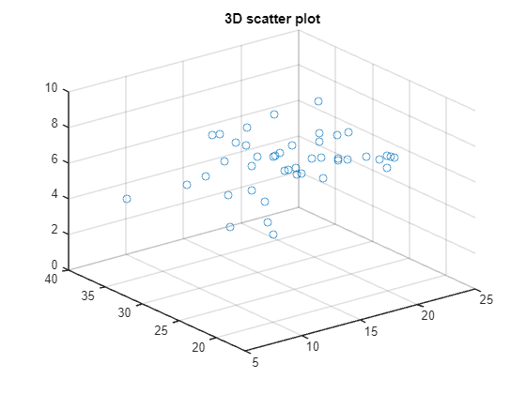
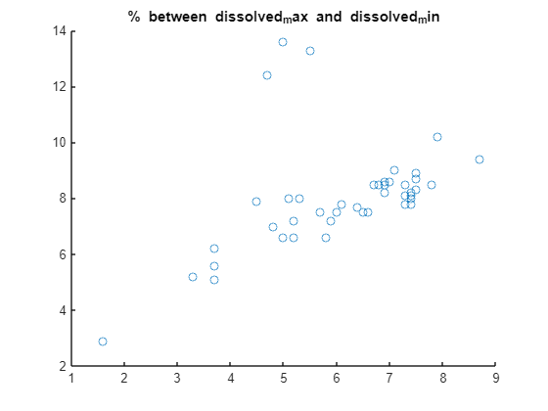
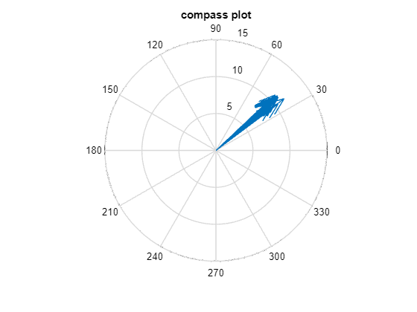
MORE OF NUMBER ONE
Relationship between Temperature_c_min2, temperature_c_max2 and dissolved_min2
temperature_c_min2 = [12 12 17 19 16 15 14 18.5 12 13 18 14 14.5 8 14 21 20 7 8 7 20 19 8 8 19 17 21 21 5 18 22 21.4 21 22 17 18 17 22 25 25 25 25 24 22];
temperature_c_max2 = [29 26 36 34 33 30 33.5 27 26 33 26 30 24 23.5 26 27 23 16 18 27 27 24 23 26 32 31 31 32 32 30 32.6 34 34 32 31 31 30 30 28 29 28 27 26 30];
dissolved_min2 = [3.3 5.9 5.8 7.4 7.4 6.5 7.3 7.8 7.3 7.5 6.7 7.3 7.1 8.7 7.5 7.4 7 6.9 7.5 6.9 7.4 6.8 6.9 7.4 4.7 6 6.1 5 5.5 6.6 7.9 3.7 3.7 3.7 1.6 5 6.4 5.2 5.2 4.8 4.5 5.3 5.7 5.1];
scatter3(temperature_c_min2,temperature_c_max2,dissolved_min2);SSSS
title('3D scatter plot');
Relationship between dissolved_max and dissolved_min
dissolved_min2 = [3.3 5.9 5.8 7.4 7.4 6.5 7.3 7.8 7.3 7.5 6.7 7.3 7.1 8.7 7.5 7.4 7 6.9 7.5 6.9 7.4 6.8 6.9 7.4 4.7 6 6.1 5 5.5 6.6 7.9 3.7 3.7 3.7 1.6 5 6.4 5.2 5.2 4.8 4.5 5.3 5.7 5.1];
dissolved_max2 = [5.2 7.2 6.6 7.8 8 7.5 8.1 8.5 7.8 8.7 8.5 8.5 9 9.4 8.3 8.2 8.6 8.6 8.9 8.2 8.1 8.5 8.5 8 12.4 7.5 7.8 13.6 13.3 7.5 10.2 5.6 5.1 6.2 2.9 6.6 7.7 7.2 6.6 7 7.9 8 7.5 8];
scatter(dissolved_min2,dissolved_max2);
title('% between dissolved_max and dissolved_min');
Relationship between minimum_ph3 and maximum_ph3
maximum_ph3 = [8 8.3 8 8.4 8.4 7.7 7.8 7.3 7.4 7.8 8.3 8 9.2 7.6 7.4 7.5 7.2 7.3 7.7 7.5 7.7 7.5 7.2 8 7.3 7.3 7.4 7.5 7.3];
minimum_ph3 = [6.7 7.3 7.5 6.3 7.2 6.9 7.1 5.7 5.9 6.7 7.4 6.6 7 7 6.8 7 6.8 6.9 6.8 6.6 7.1 7 6.6 6.7 6.5 6.8 6.8 7 6.8];
compass(maximum_ph3,minimum_ph3);
title('compass plot');

Slide 7
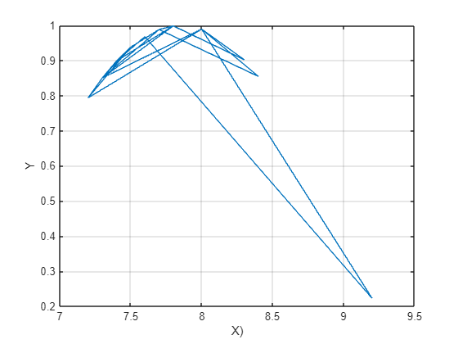
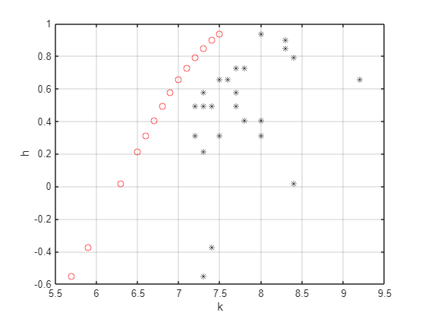
MORE OF NUMBER ONE
maximum_ph3 = x
x = [8 8.3 8 8.4 8.4 7.7 7.8 7.3 7.4 7.8 8.3 8 9.2 7.6 7.4 7.5 7.2 7.3 7.7 7.5 7.7 7.5 7.2 8 7.3 7.3 7.4 7.5 7.3];
y = sin(x);
plot(x,y,'Markeredgecolor','g');
xlabel('X)');
ylabel('Y');
grid on;
Minimum_ph3 = k
k = [6.7 7.3 7.5 6.3 7.2 6.9 7.1 5.7 5.9 6.7 7.4 6.6 7 7 6.8 7 6.8 6.9 6.8 6.6 7.1 7 6.6 6.7 6.5 6.8 6.8 7 6.8];
h = sin(k);
plot(k,h,'ro');
xlabel('k');
ylabel('h');
grid on;
hold on;
b = [8 8.3 8 8.4 8.4 7.7 7.8 7.3 7.4 7.8 8.3 8 9.2 7.6 7.4 7.5 7.2 7.3 7.7 7.5 7.7 7.5 7.2 8 7.3 7.3 7.4 7.5 7.3];
plot(b,h,'k*');

Slide 8
NUMBER TWO
In this number we used the data from number two of assignment one to visualize the relationship and characteristics of data of the group members.

Slide 9
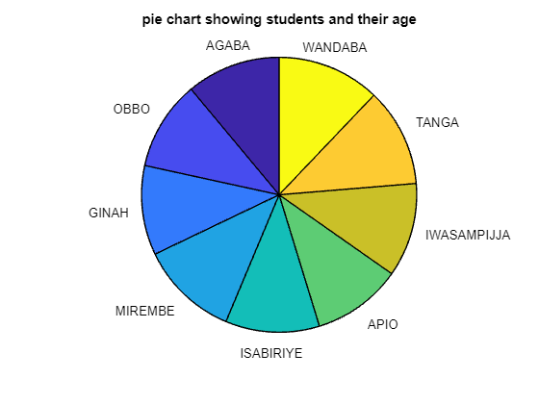
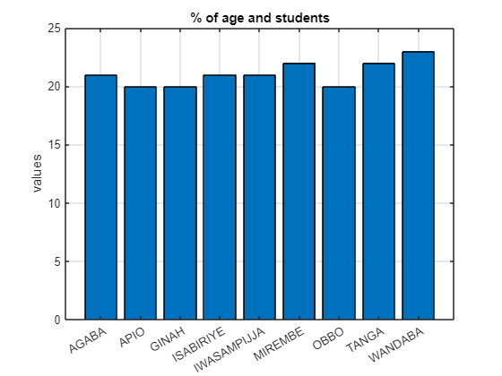
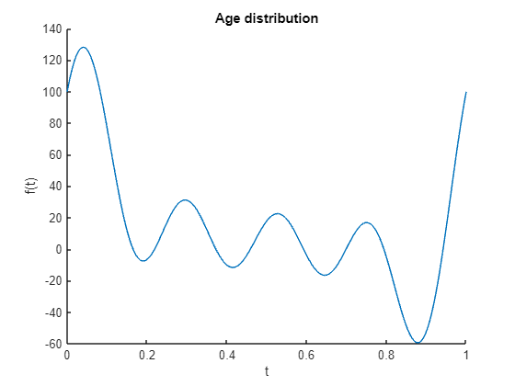
NUMBER TWO VISUALIZATION
Relationship between students and age
Age = [21, 20, 20, 22, 21, 20, 21, 22, 23];
Names = ["AGABA"; "OBBO"; "GINAH"; "MIREMBE"; "ISABIRIYE"; "APIO"; "IWASAMPIJJA"; "TANGA"; "WANDABA"];
pie(Age,Names);
title("pie chart showing students and their age");
% of age and students
Names = categorical({'AGABA', 'OBBO', 'GINAH', 'MIREMBE', 'ISABIRIYE', 'APIO', 'IWASAMPIJJA', 'TANGA', 'WANDABA'});
Age = [21, 20, 20, 22, 21, 20, 21, 22, 23];
bar(Names,Age);
ylabel('values');
title('% of age and students');
grid on;
Age patterns of students
Age = [21, 20, 20, 22, 21, 20, 21, 22, 23];
andrewsplot(Age);
title('Age distribution');

Slide 10
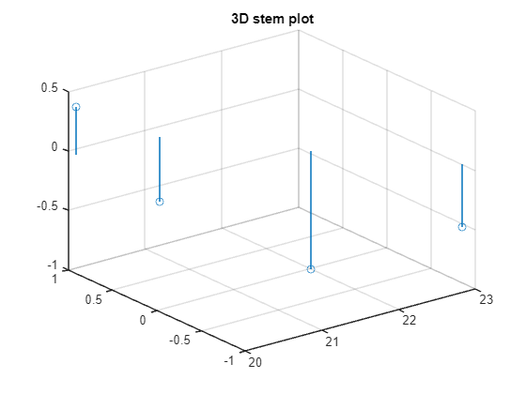
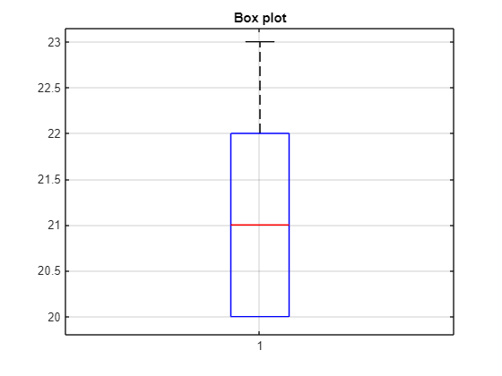
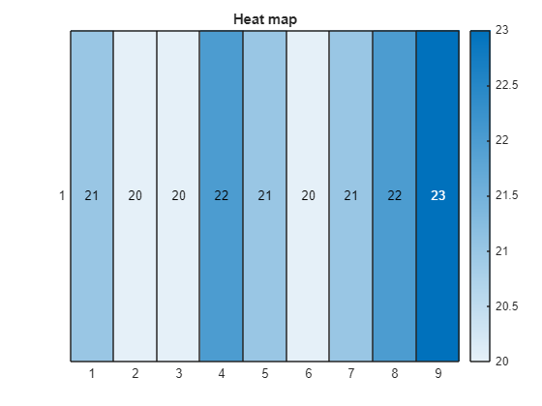
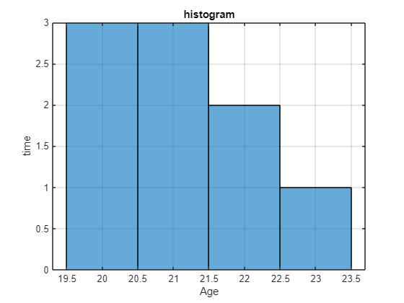
MORE OF NUMBER TWO
Age distribution
x = [21, 20, 20, 22, 21, 20, 21, 22, 23];
y = sin(x);
z = cos(x);
stem3(x,y,z);
title('3D stem plot');
Age distribution using a box plot
Age = [21, 20, 20, 22, 21, 20, 21, 22, 23];
boxplot(Age);
title('Box plot');
grid on;
Student's age distribution
Age = [21, 20, 20, 22, 21, 20, 21, 22, 23];
heatmap(Age);
title('Heat map');
Student's age distribution
Age = [21, 20, 20, 22, 21, 20, 21, 22, 23];
heatmap(Age);
title('Heat map');
Histogram of age
Age = [21, 20, 20, 22, 21, 20, 21, 22, 23];
histogram(Age);
xlabel('Age');
ylabel('time');
title('histogram');
grid on;

Slide 11
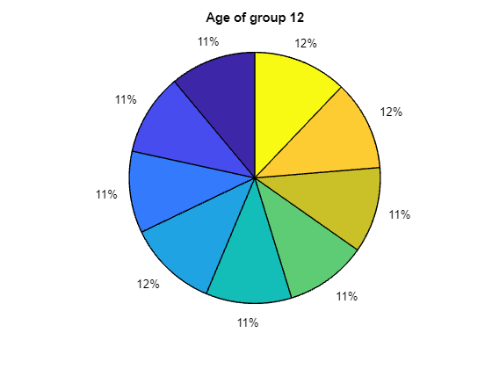
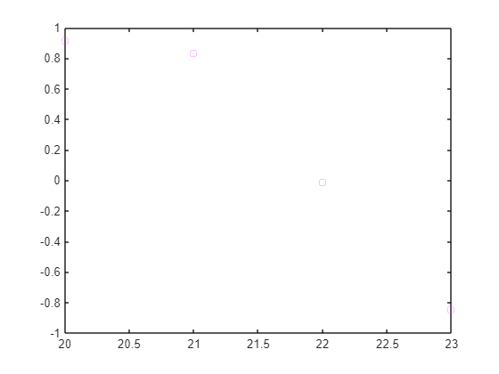
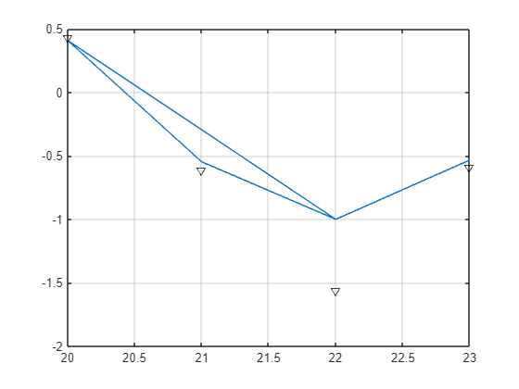
MORE OF NUMBER TWO
Pie chart of age
Age = [21, 20, 20, 22, 21, 20, 21, 22, 23];
pie(Age);
title('Age of group 12');
Graph of age(x)
x = [21, 20, 20, 22, 21, 20, 21, 22, 23];
y = sin(x);
plot(x,y,'ms');
GRAPH 2
x = [21, 20, 20, 22, 21, 20, 21, 22, 23];
y = cos(x);
plot(x,y);
hold on;
z = tan(y);
plot(x,z,"kv");
grid on;

Slide 12
CONCLUSION
The second assignment helped the participants to get more skills in data visualization and acquire key hands on experience.

